Slide 1
Now Try This – NOW
Initial Thoughts
NTTs are currently too delayed. It can be up to 3 weeks before students act on the feedback from the time the classwork was completed.
A lot of time is page turning in exercise books for marking, looking for mistakes from the class marking. Can marking be more targeted?
Is peer marking dead time? What do the students get from a list of answers either right of wrong?

Slide 2
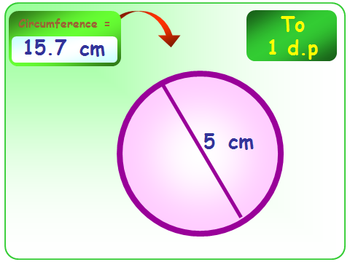
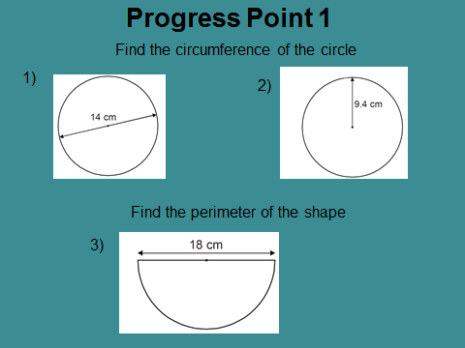
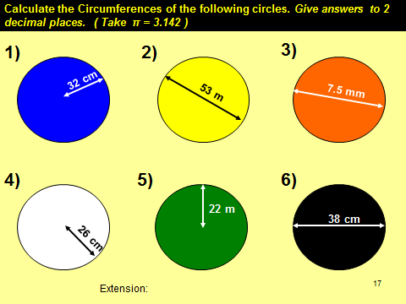
How are maths lessons broken down?
Learning Outcomes
Teacher Lead Examples
Starter
MWB
Progress Point
Exercise
Typical 20/30 mins

Slide 3
Progress Point Examples
Differentiated
Problem Solving
Real Life Examples

Slide 4
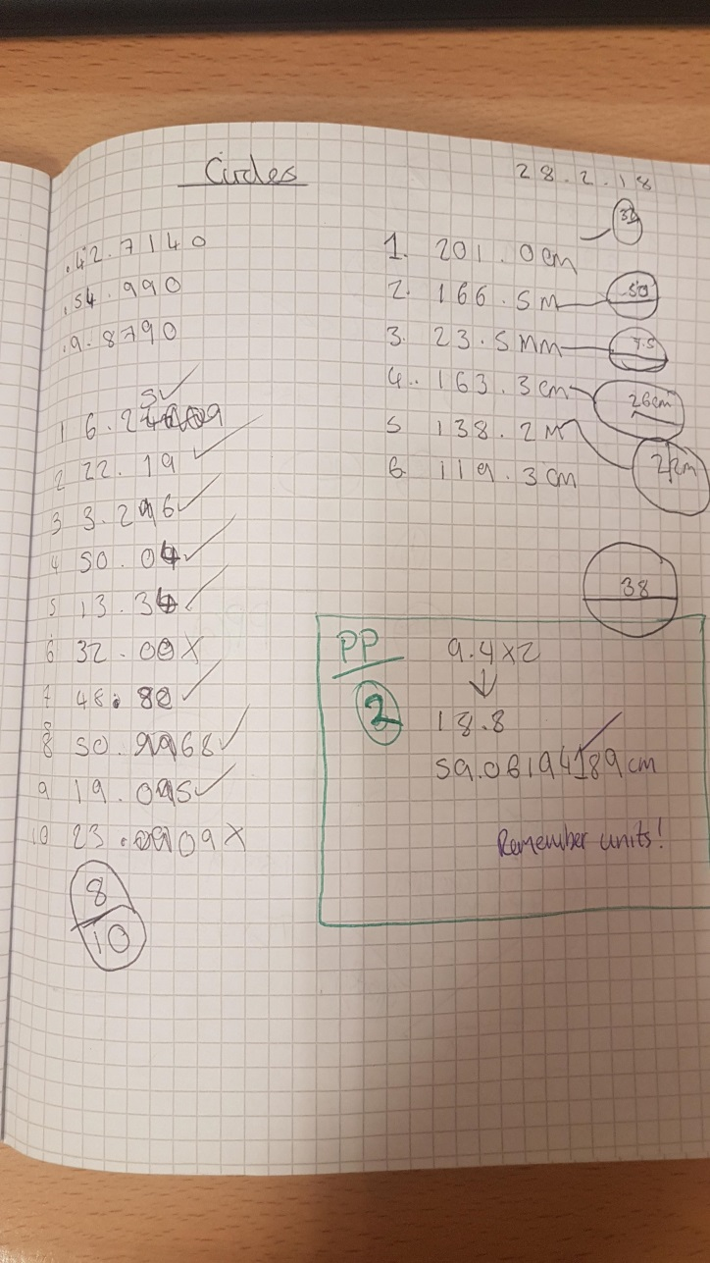
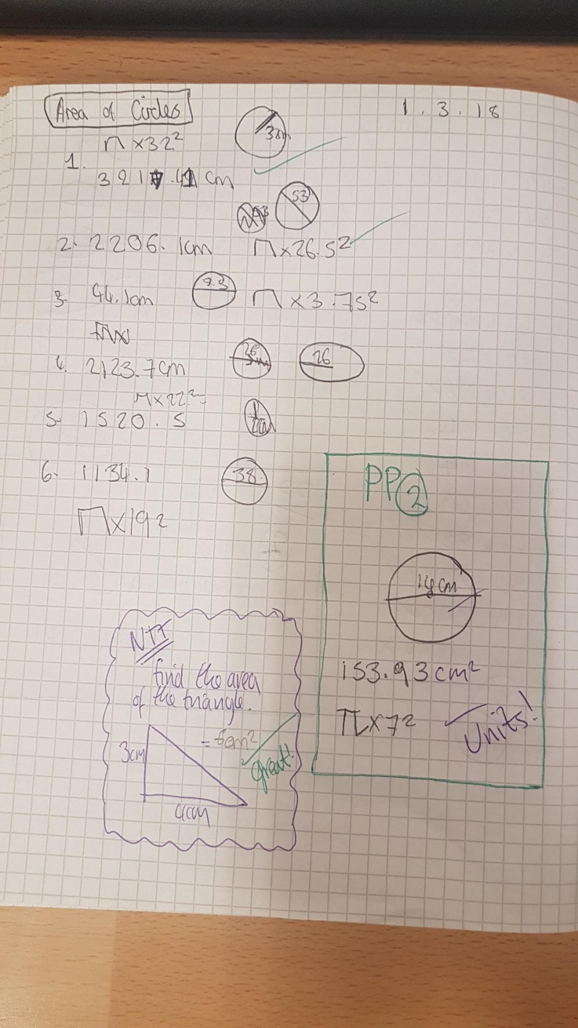
What did it look like in the books?

Slide 5
Now Try This – NOW
Progress Points
Much of the AFL is done on MWB, misconceptions are ironed out before students attempt the exercise.
Exercise was not marked. Emphasis was put on the progress point for assessing final understanding.
Progress Point has differentiated questions, students either choose themselves or are guided by teacher while circulating during previous exercise.
During next exercise, teacher circulates marking the progress points.
End of lesson, teacher only has the final progress point to mark, and feedback, future teaching can be based on this.

