Slide 1
Gallery Critique

Slide 2
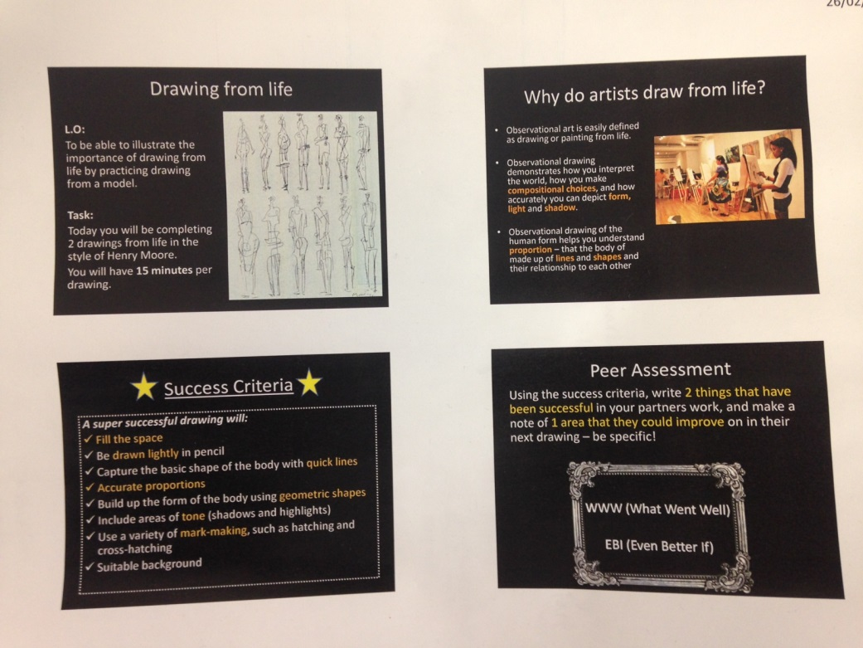
Gallery Critique - Overview
Gallery critique is when students spend an extended period of time assessing the work of their peers, giving high quality, specific feedback based on the success criteria outlined by the teacher.

Slide 3
Advantages
Students are made aware of ‘success criteria’ for each piece of work
Students start to ‘think like the teacher’
Students respond particularly well to feedback from peers
Targets set by peers can be acted on immediately or in a future lesson
Progress is evident quickly
Teacher does not need to put any marking on the work

Slide 4
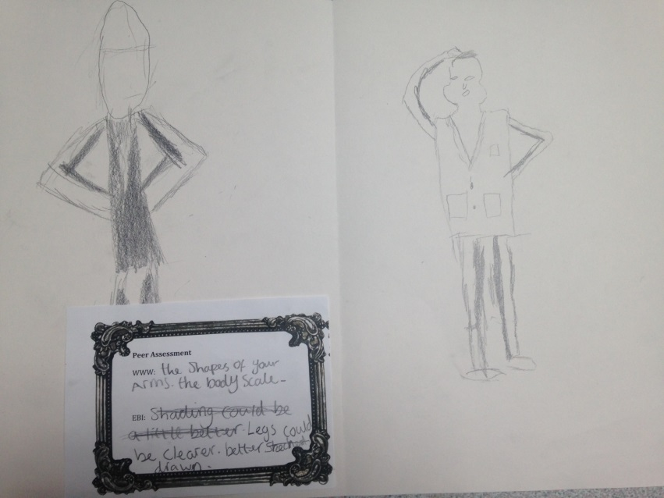
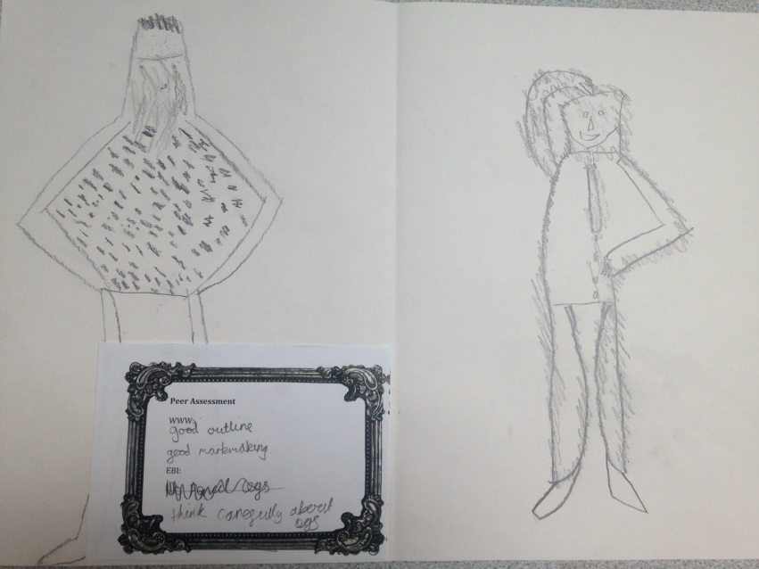
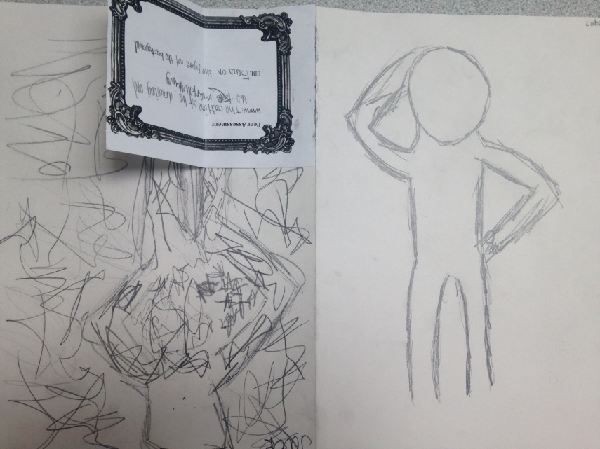
Examples – drawing from direct observation

Slide 5
Peer Assessment sheet
WWW:
EBI:

